Slide 1
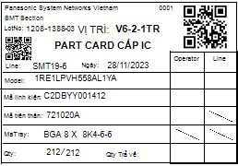
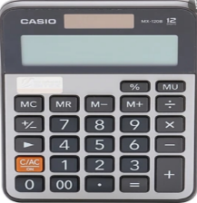
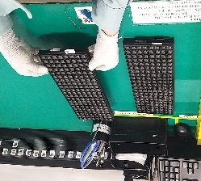
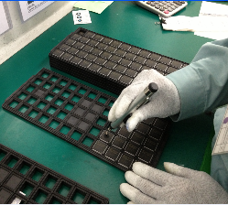
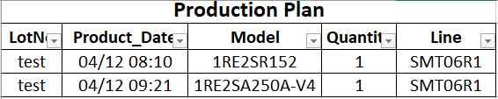
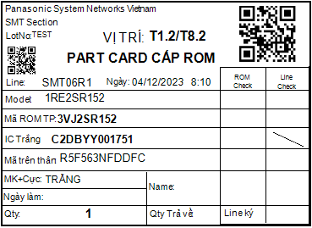
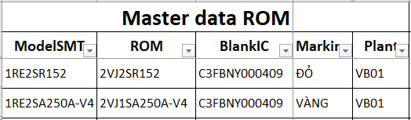
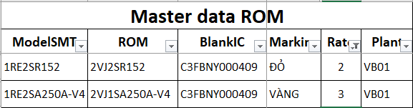
Efficiency
REDUCE MANUAL JOB TO INCREASE EFFICIENCY
Team: Develop Team
Expn: 0 K USD
Issue date: Dec.2023
Status: Ideas
Before
After
1.Part card IC/PCB/Rom
1.Part card IC/PCB/Rom
Only indicate production plan.
quantity ornigin tray
quantity odd pcs
Indicate more detail quantity ornigin tray & odd tray.
quantity ornigin tray
quantity odd pcs
212 : 96 = 2.21
2 X 96 - 212 = -20
212 : 96 = 2.21
2 X 96 - 212 = -20
212 : 96 = 2.21
212 : 96 = 2.21
Qty: 212
Qty: 212 = 2 tray + 20 pcs
212 : 96 = 2.21
Check production plan
on part card
Calculate quantity
ornigin tray
Pick up tray
Calculate quantity
odd pcs
Pick up IC
Check production plan
on part card
Calculate quantity
ornigin tray
Pick up tray
Calculate quantity
odd pcs
Pick up IC
Standard time:
20 Sec/part
150 Sec/part
20 Sec/part
120 Sec/part
Standard time:
0 Sec/part
150 Sec/part
0 Sec/part
120 Sec/part
2.Part card Rom
3.Part card IC/PCB
2.Part card Rom
3.Part card IC/PCB
1
Qty: 212
Blank
2
Qty: 212
“ ”
All model
mounting point = 1 point
Qty = Q’ty production
Add new model
mounting point > 1 point
Qty = Q’ty production x mounting point
Standard time: 40 sec/part
Average part kitting: 765 part/day
→ Total time calculate: 40*765 = 8.5 h/day
Standard time: 0 sec/part
→ Save time calculate: 40*765 = 8.5 h/day ~△1 pax
ROI:
0 Year
Effective date： Jan.2024
Expected effect：
Save cost: △6,000 $/ Y
Notes:
With mindset fastest and lowest cost.
We deeply discus with PV member to improve panaCIM function for this issue
This function can automation calculate
Show component position and remaining time component status before part empty.
Otherwise we set material stage by stage to reduce moving distance become to Zero.
After action we can save 11,440mins/Y

